Slide 1
QR = Accuracy – It’s a Fact
IRS reviews showed:
Volunteers who prepared returns using a complete Intake/Interview and Quality Review Process achieved 100% accuracy rate
Volunteers using an incomplete or non-existent Intake/Interview and Quality Review Process attained only 77% accuracy rate

Slide 2
Quality Review
IRS site reviews consistently report that quality review process has been a significant weak area
Deficiencies include:
Failure to refer to Intake Booklet (Form 13614-C)
Little or no engagement with taxpayer
Checking only if data are properly entered without evaluating overall return
Failure to inform taxpayer that return is their responsibility
Notes:
Quality review has been a consistent weak area every year in IRS Site Reviews

Slide 3
Requirements
Quality Review:
On ALL returns
By second certified counselor
In presence of taxpayer(s)
After return is prepared, but before taxpayer signs return
Don’t share refund monitor results until QR is complete
Notes:
Counselors must be certified for the specific tax year when reviewing prior year returns.

Slide 4
Quality Review Methods
Designated reviewer
Designated quality reviewer
Dedicated to reviewing completed returns
Conducted at preparer’s computer or separate station
Peer review – volunteers exchange returns
Self-review – never acceptable
Notes:
Designated review can be done at the preparer’s computer or at a separate station as decided by the Local/Site Coordinator
However, it must always have the taxpayer present

Slide 5
Keys to an Accurate Quality Review
Involvement of taxpayer(s)
Thorough review of Intake Booklet
Careful review of return in TaxSlayer
All errors/deficiencies corrected
Comparison with last year’s return (if available)

Slide 6
Obstacles to an Accurate Quality Review
Basic assumption is that the return you are reviewing is correct
If you have any doubt about an issue, discuss with preparer out of taxpayer’s hearing
Fear of flagging an error if preparer has more experience or knowledge
Especially true if not just a data entry problem
Especially true if preparer is Site Coordinator, trainer, mentor, etc.
Time constraints if site is very busy or if behind appointment schedule

Slide 7
Review Intake Booklet
Preparer noted any changes, new information, clarifications, etc. on Intake Booklet?
Parts I & II – verify with taxpayer as needed
Check name and address on Social Security cards and driver’s license against Intake Booklet. Verify reason for discrepancies.
Is all info present to make correct Filing Status decision?
Are all people living with or supported by taxpayer listed?
Were dependent questions (gray section) properly answered?
Notes:
Have note pad available to take notes on specific items to check like capital loss carryover.

Slide 8
Review Intake Booklet
Part III - Income
Tax documents match appropriate checked boxes
All checked boxes have a corresponding document (if appropriate)
All “Unsure” or unmarked boxes are resolved
Always ask taxpayer if there is any other income not reflected by Intake Booklet or tax documents

Slide 9
Review Intake Booklet
Part IV – Expenses
Expenses are understood sufficiently to determine if they might be eligible expenses for an adjustment or credit
All available adjustments to income identified
All available credits identified

Slide 10
Review Intake Booklet
Part V – Life Events
Confirm all events affecting return
Pay attention to estimated tax payments
Check for capital loss carryover
Often least understood by taxpayers and overlooked by Counselors
Check last year’s return to see if it should carryover to this year’s return
Infrequently seen items sometimes out-of-scope
Check for health insurance purchased through the Marketplace and associated Form 1095-A
Notes:
Note that “Did you receive a letter from the IRS?” has been moved to this section to be more prominent

Slide 11
Review Intake Booklet
Page 3 – Additional Information
Did taxpayer receive a letter from IRS?
How might the letter affect this year’s tax return?
Does taxpayer need help in responding to letter?
Note any direct deposit/direct debit preference
Check notes that have been added
Create additional notes if applicable

Slide 12
Conducting a Quality Review (QR) in TaxSlayer
Approaches to QR in TaxSlayer include:
Reviewing the QR Print Set OR
Retracing preparer’s steps OR
Reviewing Summary/Print and linking to input screens
QR on computer rather than printed return
Incomplete/missing forms are apparent
Ease of updating errors
Saves paper and ink/toner
Notes:
There is no one-size-fits-all process. For example, if the return is a very simple one, retracing the preparer’s steps is probably the most efficient and quickest way to review the return. Conversely, for a return that has multiple W-2s and/or 1099-Rs, it may be more effective use the QR Print set
The following slides demonstrate one method for conducting a quality review

Slide 13
Conducting a Quality Review in TaxSlayer
Techniques vary from one counselor to another
No one-size-fits-all technique
QR may use one or a combination depending on nature of return
Notes:
There is no one-size-fits-all process. For example, if the return is a very simple one, retracing the preparer’s steps is probably the most efficient and quickest way to review the return. Conversely, for a return that has multiple W-2s and/or 1099-Rs, it may be more effective use the QR Print set
The following slides demonstrate one method for conducting a quality review

Slide 14
Verify TaxSlayer Info Against Source Documents
Check Basic Information
Personal info of taxpayer and spouse
Must match SS cards, driver’s licenses, and Intake booklet
Filing status correctly determined
Correct dependents claimed
No one was claimed who does not meet dependency eligibility
Everyone who does meet dependency eligibility was claimed
Dependent personal information
Must match SS cards and Intake booklet
Notes:
Discuss what changes, additions, and deletions need to be made to the Intake Booklet

Slide 15
Verify TaxSlayer Info Against Source Documents
Compare Income/Expenses/Life Events sections of Intake Booklet and source documents against forms in return. Is anything missing?
Can compare against Listing of Forms in this Return
Can compare against Quick Summary page showing income sources
Can compare against 1040 and Schedules 1-3
Compare specific printed source documents against info in TaxSlayer. Look for missing info, typos, transposed numbers, incorrect addresses, etc.
Can compare against input screens
Can compare against documents printed in Quality Review print set
W-2s, 1099-Rs, 1099-MISCs
Notes:
Discuss what changes, additions, and deletions need to be made to the Intake Booklet

Slide 16
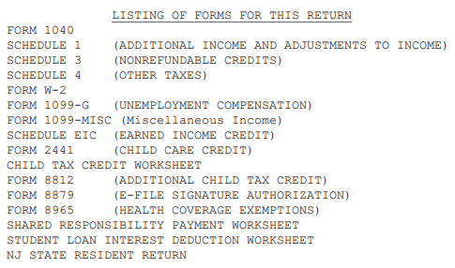
Listing of Forms for this Return
Notes:
Discuss what changes, additions, and deletions need to be made to the Intake Booklet

Slide 17
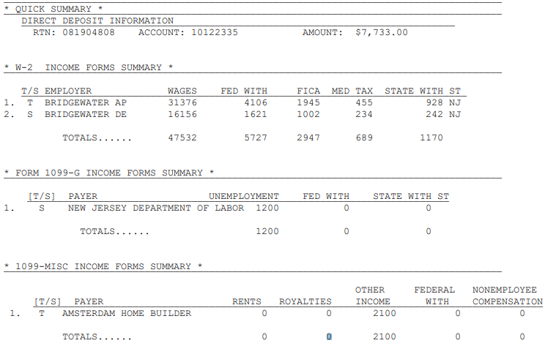
Quick Summary of Income Sources
Notes:
Discuss what changes, additions, and deletions need to be made to the Intake Booklet

Slide 18
Verify TaxSlayer Info Against Source Documents
Compare Adjustments to Income against Schedule 1 and check supporting worksheets
Compare Itemized Deductions against Schedule A
Check appropriate Credit Forms to be sure that credit was calculated as expected
Form 2441 for Child and Dependent Care Credit
Schedule EIC for Earned Income Credit and Worksheets A and B
Schedule 8812 for Additional Child Tax Credit
Notes:
Discuss what changes, additions, and deletions need to be made to the Intake Booklet

Slide 19
Verify TaxSlayer Info Against Source Documents
Verify other Schedules and Worksheets against source documents or taxpayer’s verbal statements
Child Tax Credit Worksheet
Determine that all Income Tax Withholdings and Estimated Tax Payments are correct
Verify direct deposit/direct debit decision with taxpayer
Check bank account information on Quick Summary page
Be sure to check return type selected for both Federal and State
Choices not in same order
Return will not be e-filed if paper return is erroneously chosen
Notes:
Discuss what changes, additions, and deletions need to be made to the Intake Booklet

Slide 20
Make Necessary Changes
Review any necessary changes with preparer
Be discreet in front of taxpayer
Discuss any disagreements out of area
Determine who will make changes on Intake Sheet or in TaxSlayer
Choose Quality Reviewer in E-file section
Mark return complete
Notes:
Discuss what changes, additions, and deletions need to be made to the Intake Booklet

Slide 21
Practice Quality Review Exercise
Good idea to train on a practice quality review exercise with both new and experienced volunteers
Set up a completed Intake/Interview form, scenario and associated return in TaxSlayer
Purposely have incomplete or inaccurate info on Intake/ Interview form
Include mistakes in filing status, dependencies, eligibility for credits, etc.
Include data entry errors
Notes:
Discuss what changes, additions, and deletions need to be made to the Intake Booklet

